Slide 1
How to take risks without getting clawed in the face
Thomas Rayner
Sr. Security Service Engineer
Microsoft
🐺

Slide 2

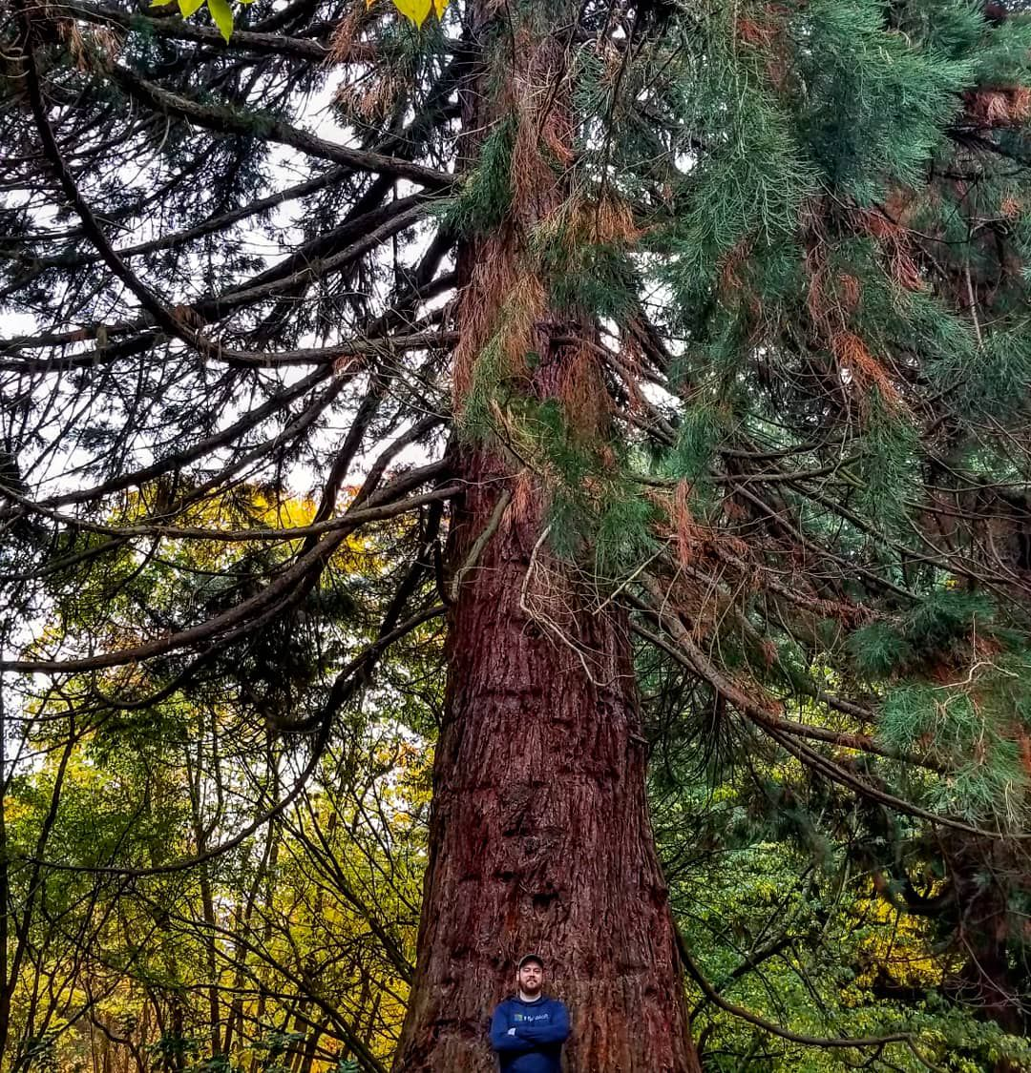

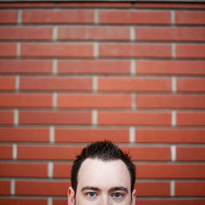
Obligatory Bio Slide
I work at Microsoft on a pretty cool team
I used to work at some other cool places doing cool things, used to be an MVP
You can find me all over the place
@MrThomasRayner
thomasrayner.ca
github.com/thomasrayner
PowerShell Discord/Slack
Join: j.mp/psdiscord or j.mp/psslack
pluralsight.com/authors/thomas-rayner
Master PowerShell Tricks books
🐺

Slide 3
Story Time
🐺
I got clawed in the face

Slide 4
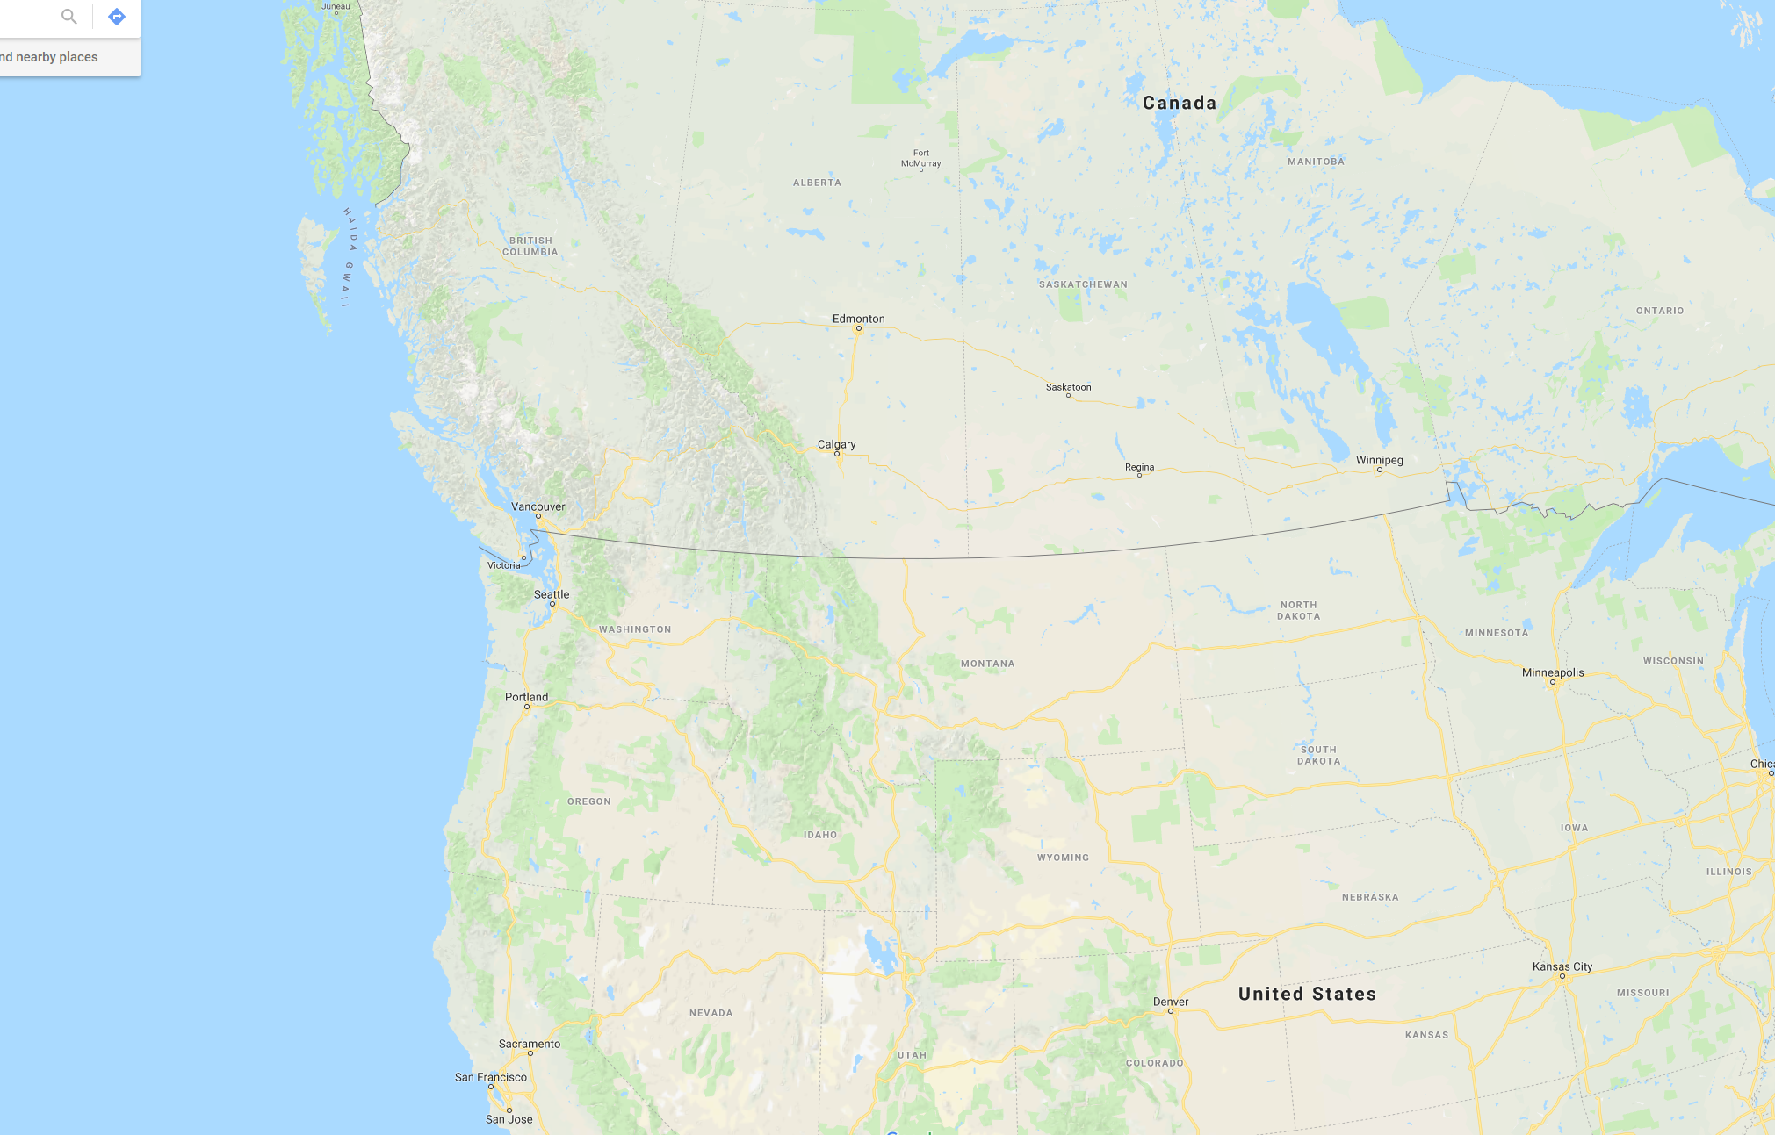
Edmonton, AB
Redmond, WA
Notes:
We are here in Redmond
I am from Edmonton originally, where I lived at the time of this story

Slide 5
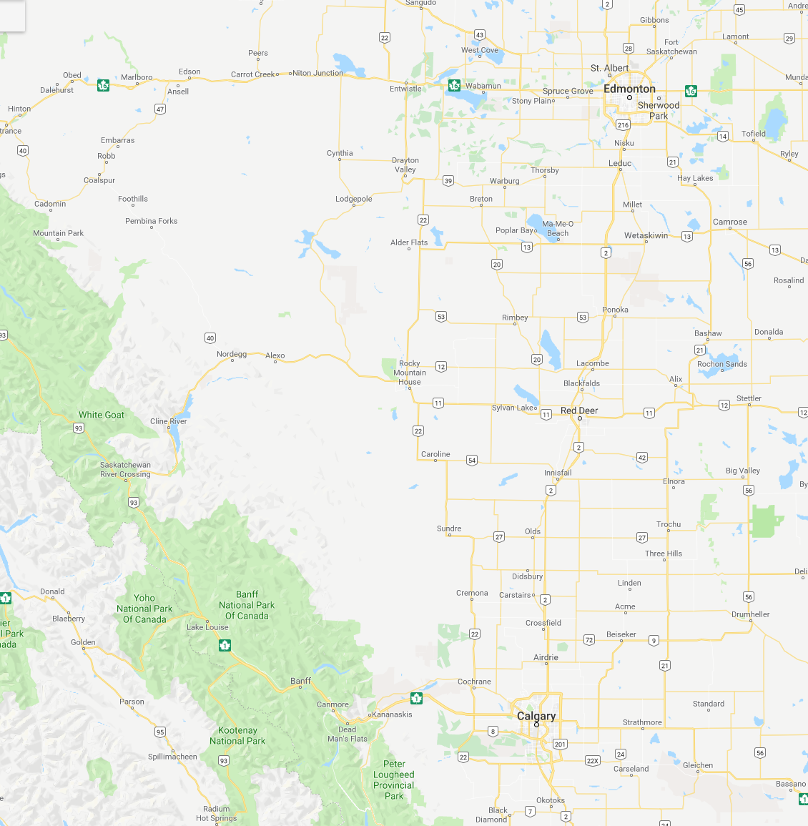
Home
Banff
Notes:
About 4.5 hour drive south west of Edmonton is Banff
We love Banff, it’s gorgeous

Slide 6
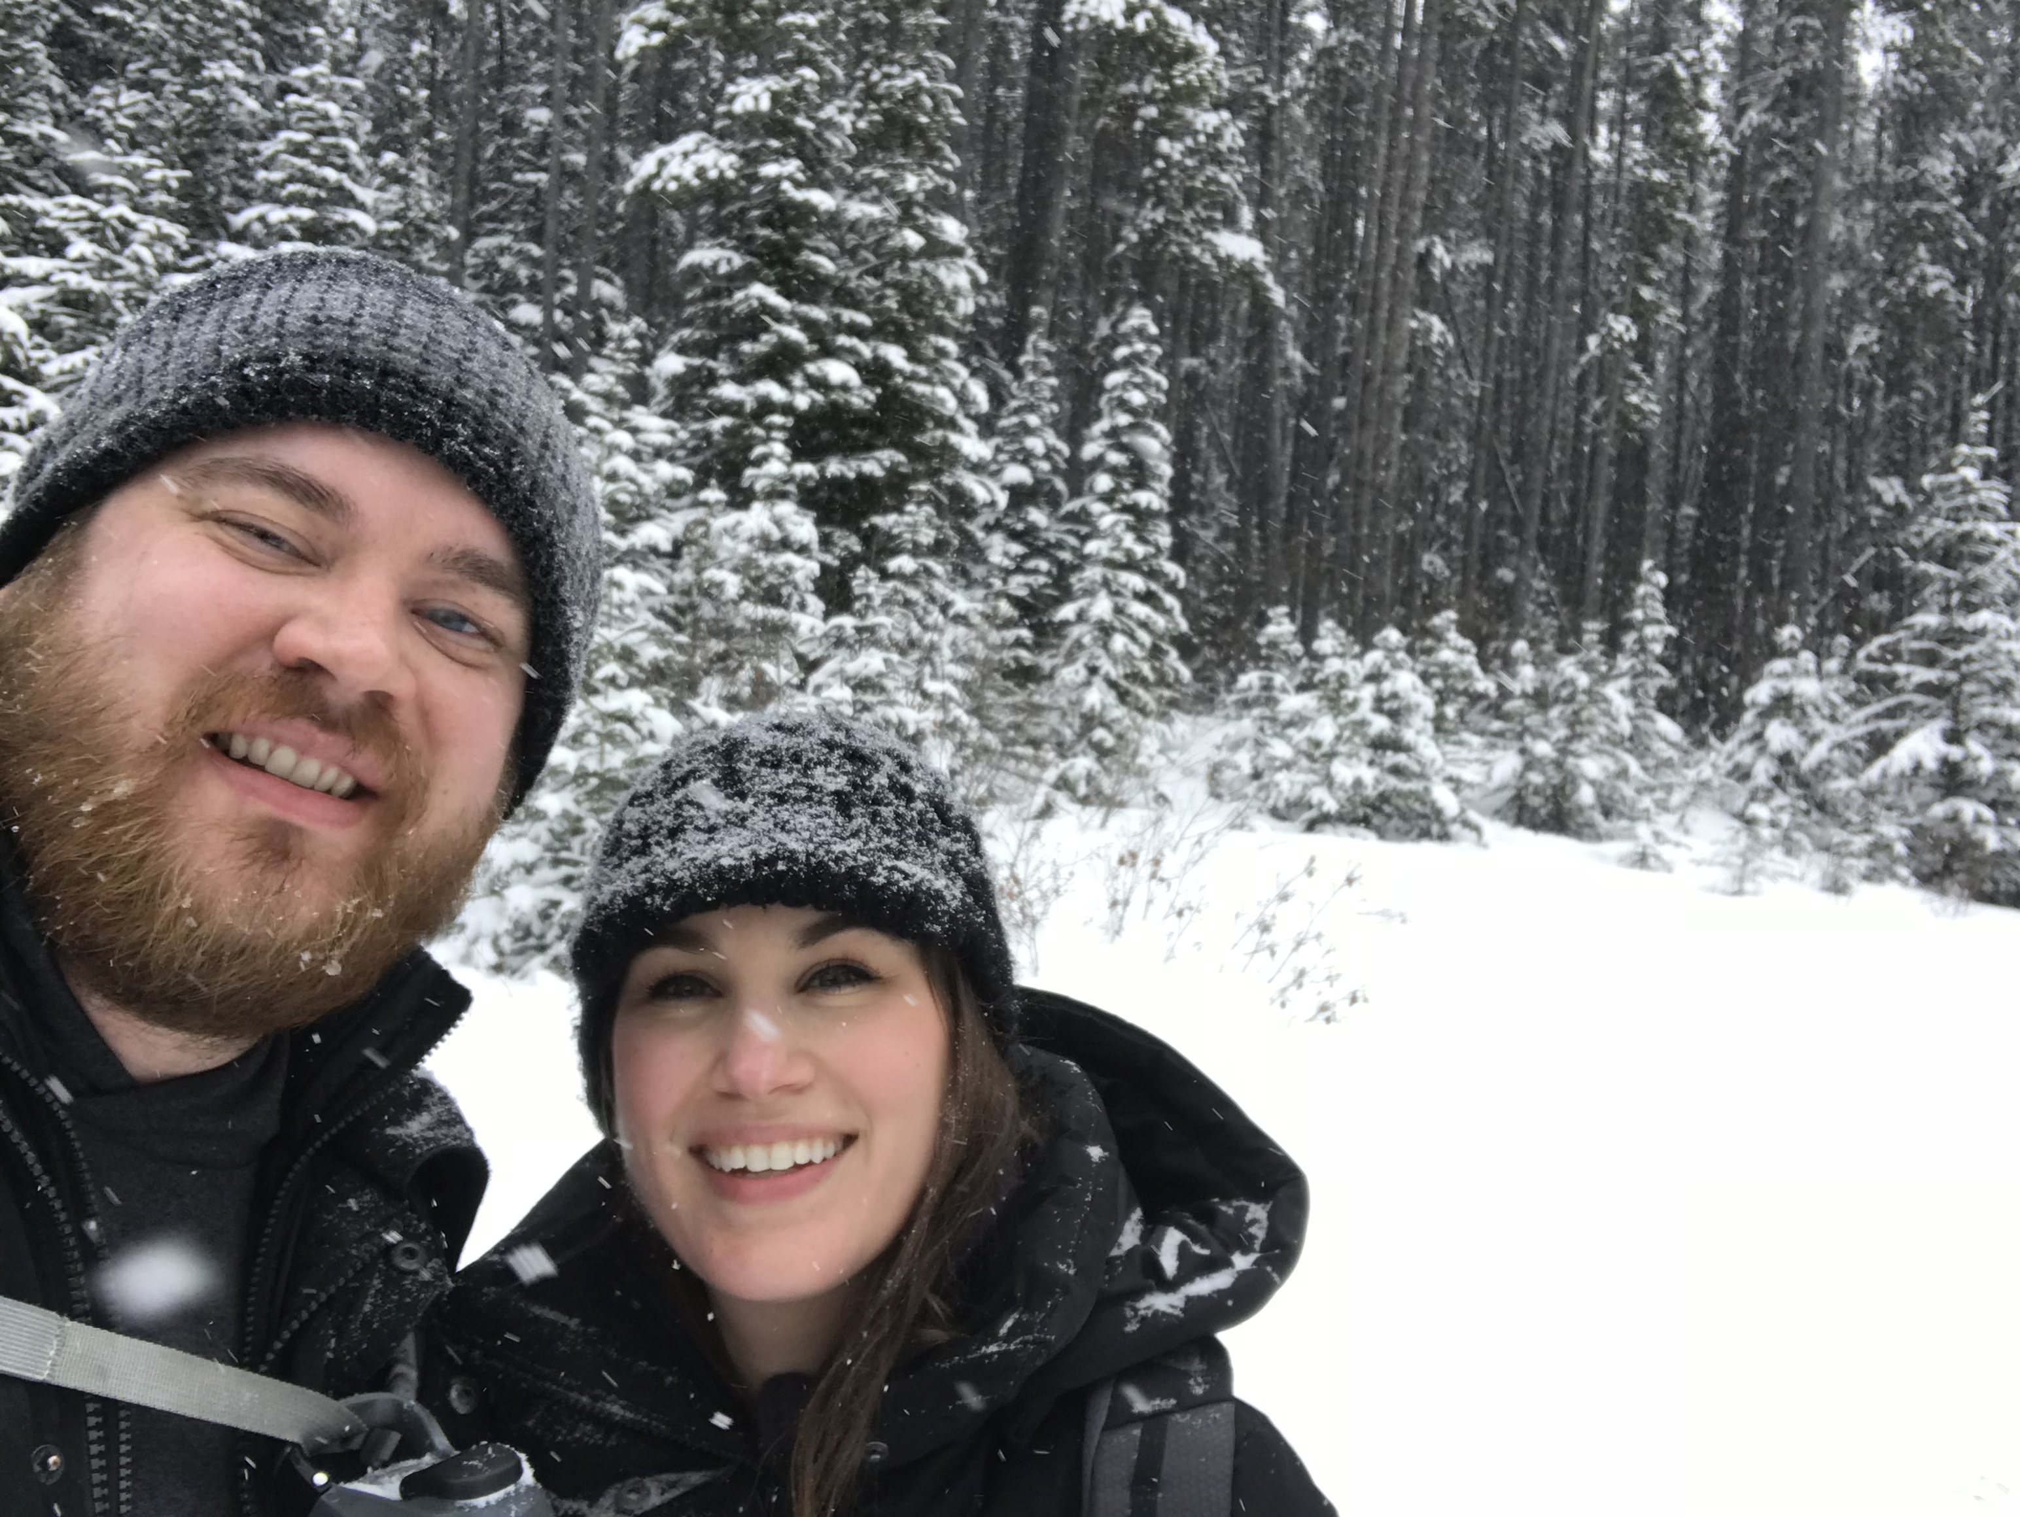
Notes:
We hiked
I got snow in my eye
Looks like nice weather, eh?

Slide 7
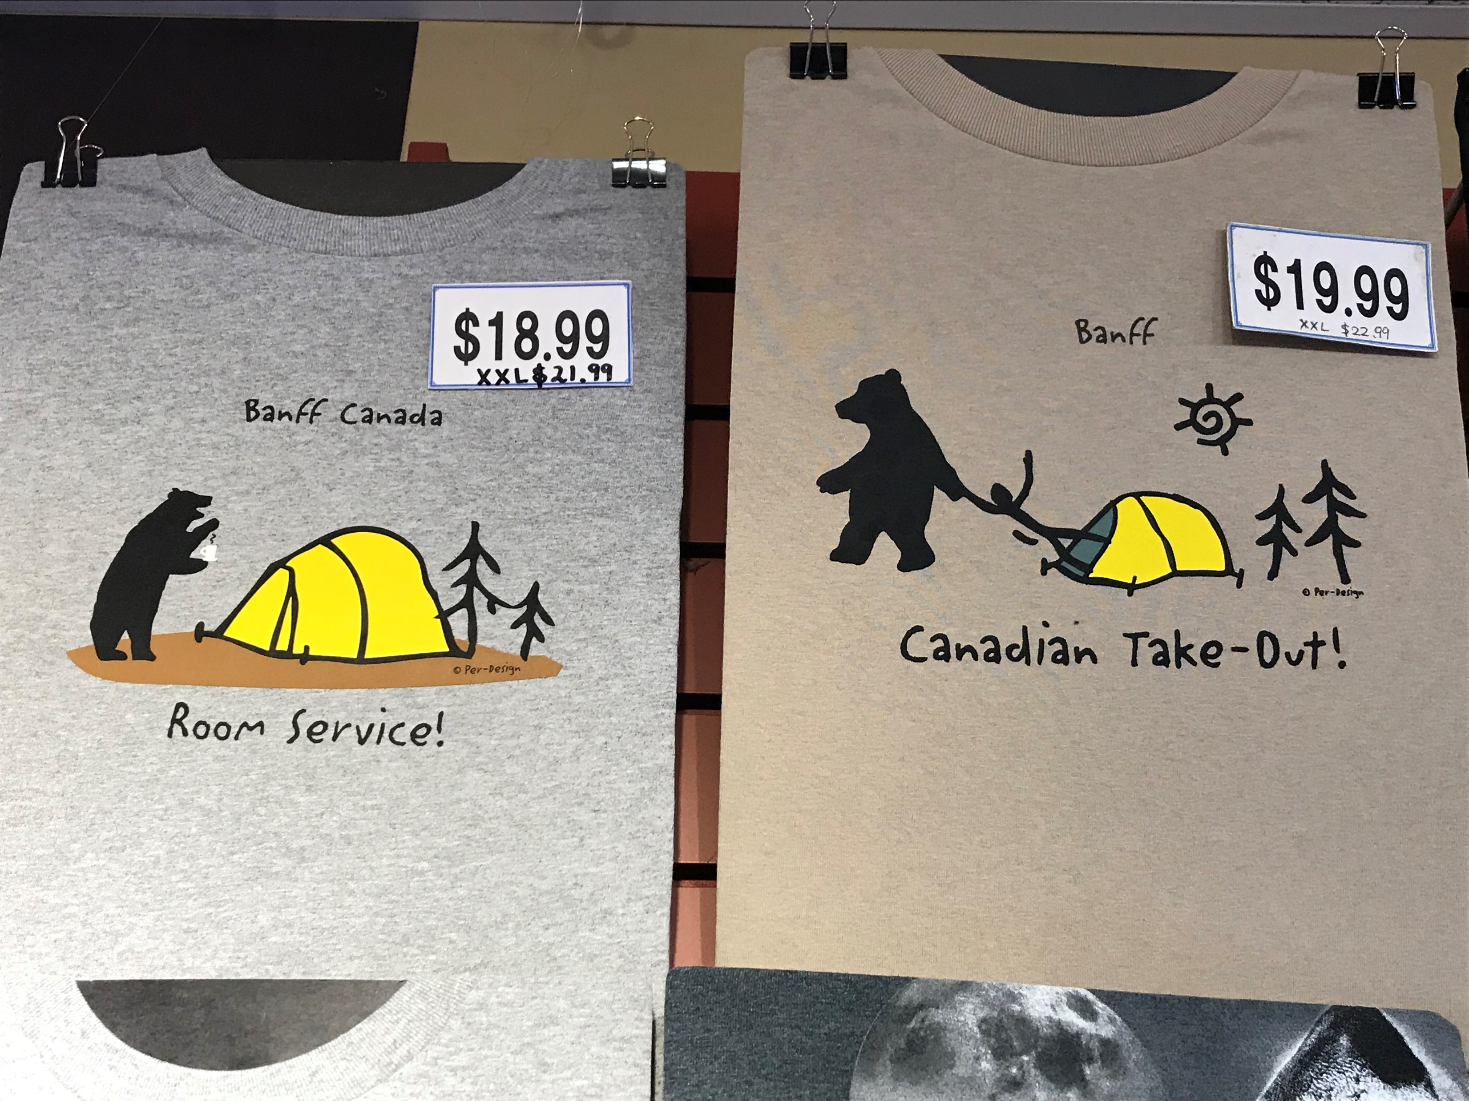
Notes:
We visited some local shops selling goods from the area

Slide 8
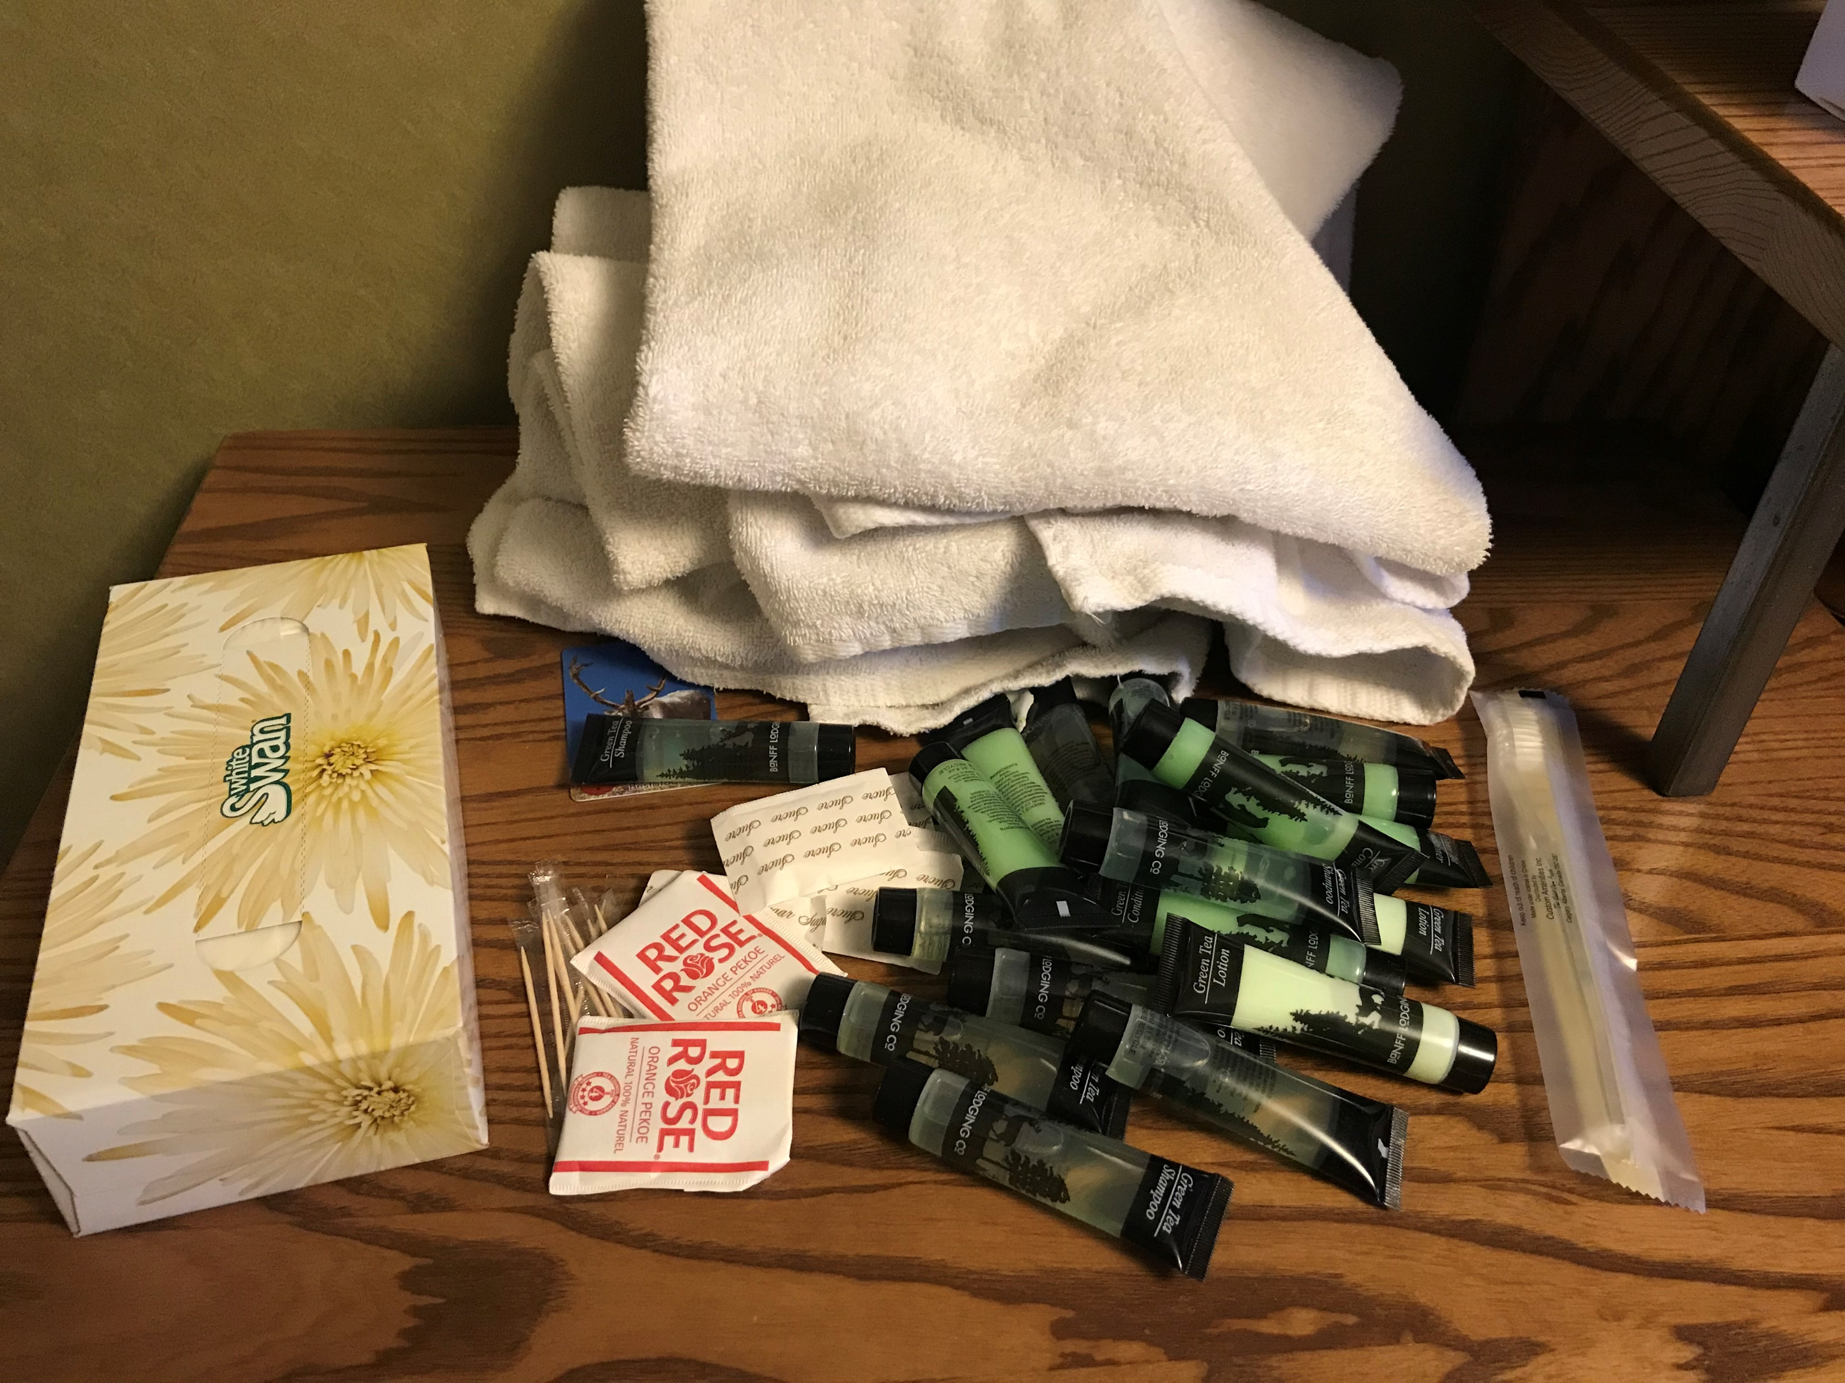
Notes:
We stayed at a really nice hotel
This place was super rustic, but gorgeous and comfortable at the same time
There was an unattended housekeeping cart

Slide 9
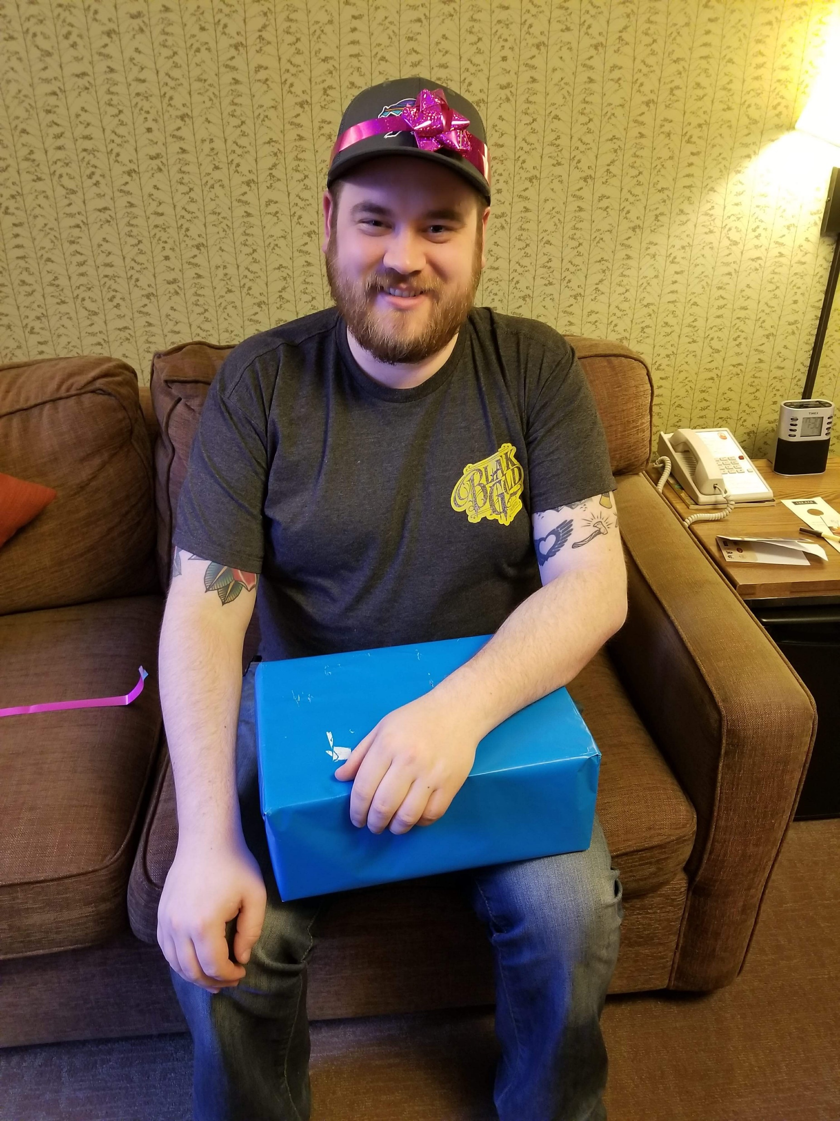
Notes:
Remember how it was my birthday?
I opened a couple gifts and got the coolest surprise ever

Slide 10
Home
Golden
Banff
Notes:
Let’s look at the map again for a second
A little further west of Banff, is a small town in BC called Golden
What is there in Golden?
Skiing, hiking, tours…
And…

Slide 11
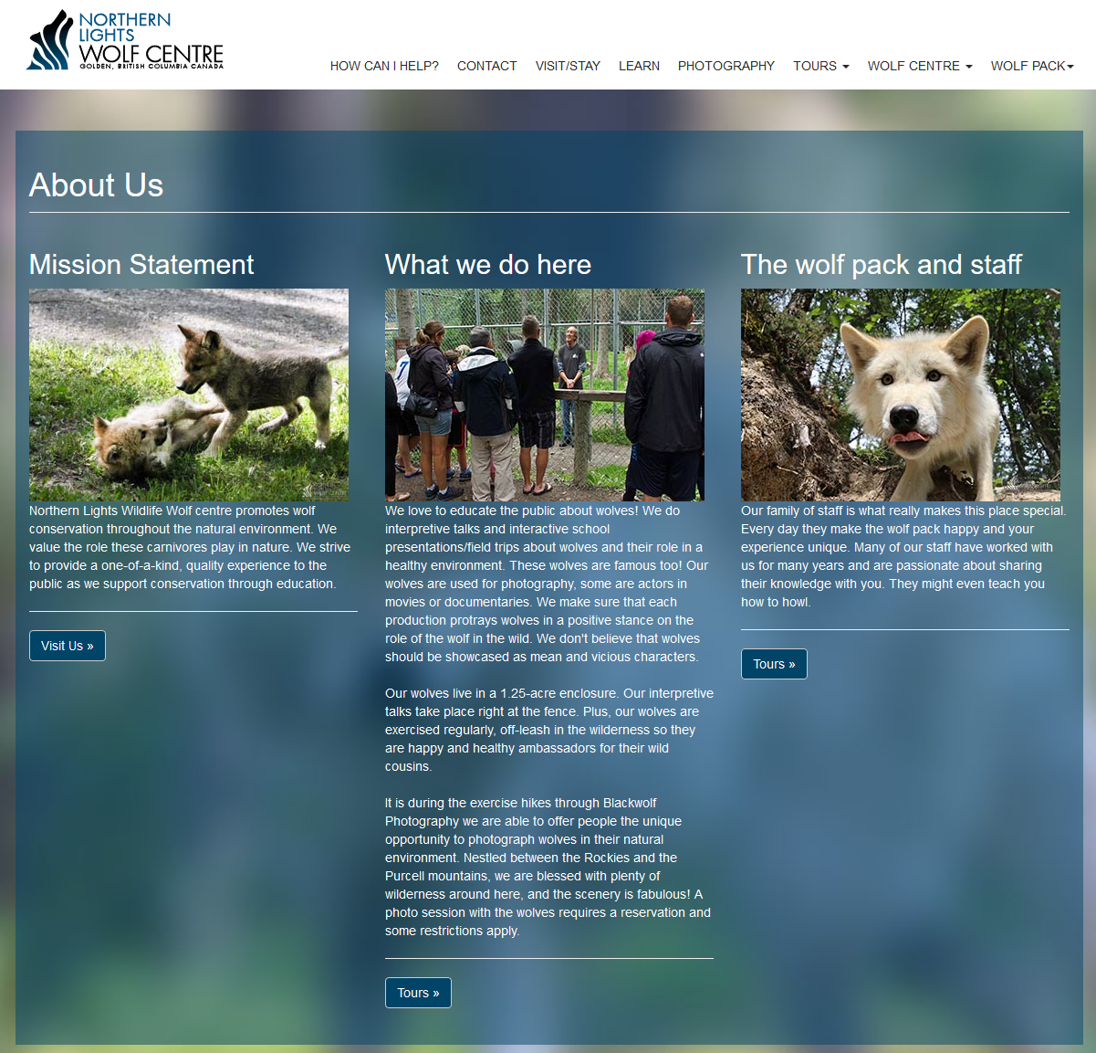
Notes:
The Northern Lights Wolf Centre!!!
This place is incredible
Rescue wolves from bad situations
Wolves that can’t go back into the wild
Interpretive center
Real. F-ing. Wolves.

Slide 12
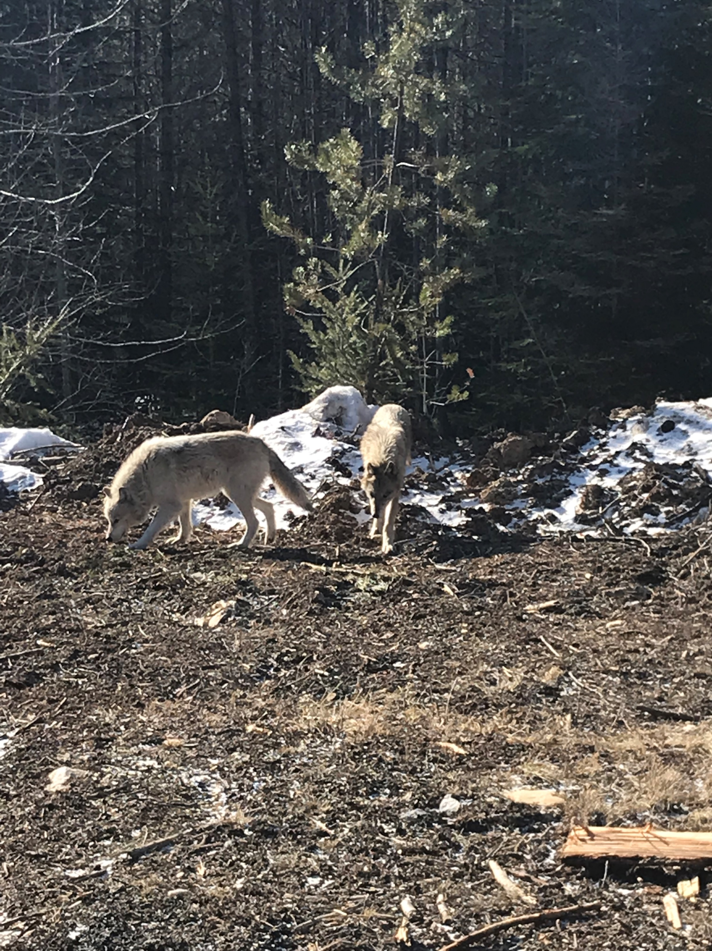
Flora
Uno
Notes:
These are real, not fooling around, actual wolves
You go for a little hike with them
The interpreters are in control
The wolves run around, dart in and out of your small group
It’s surreal
They are not dogs
By the way, these are two of the smaller ones
A female and a younger male
Flora and Uno
Can you guess why he’s named Uno?

Slide 13
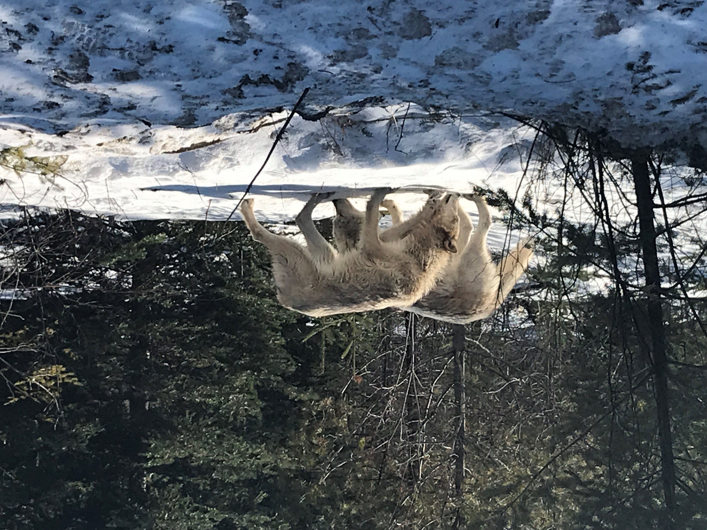
Notes:
Before you go, you sign some waivers releasing rights to photos
Includes language about “these are wild wolves, although they’ve been imprinted on humans, this isn’t like visiting your friend’s labradoodle. These are wolves, and wolves can be dangerous and unpredictable”
The guides are amazing – knowledgeable, informative, and this is a tourist attraction, so you feel pretty safe
We understood and accepted the risks before we embarked on our walk

Slide 14
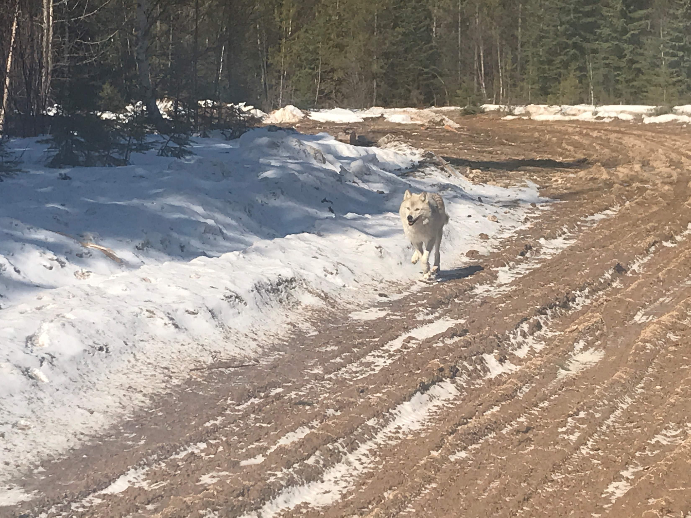
Notes:
They’re fast and nimble as heck
We had enough trouble on this little logging road
Wolves are obviously built for this and much more
Super impressive animals, humbling

Slide 15
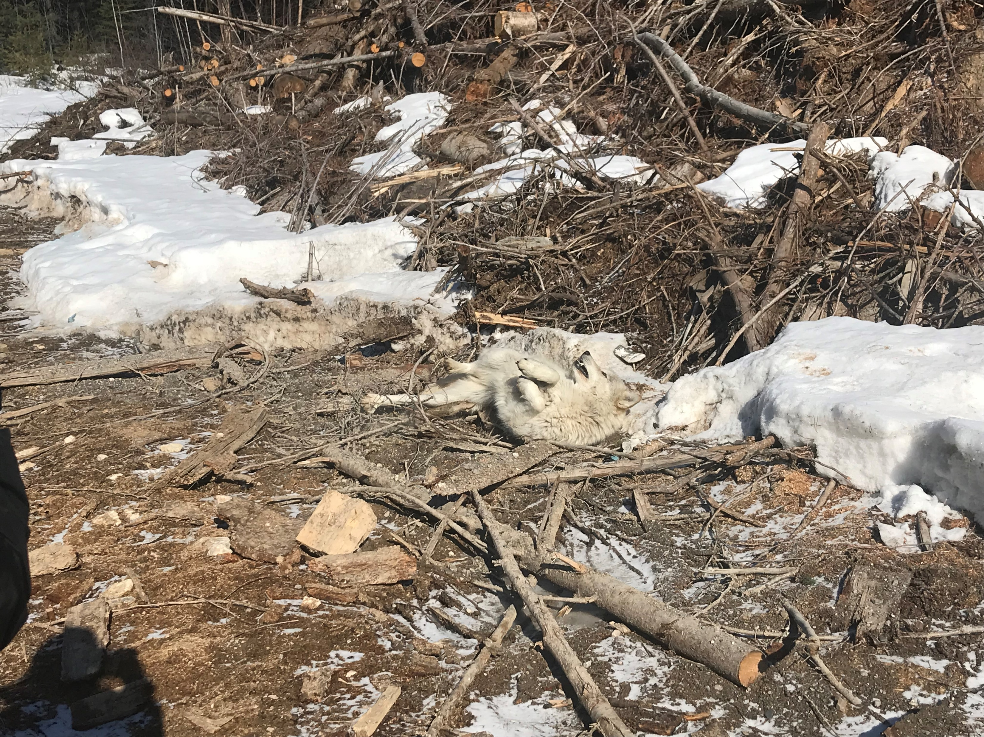
Notes:
You can kind of see some dog like behavior in them
They’re happy, they play, they roll around in gross stuff that smells interesting

Slide 16
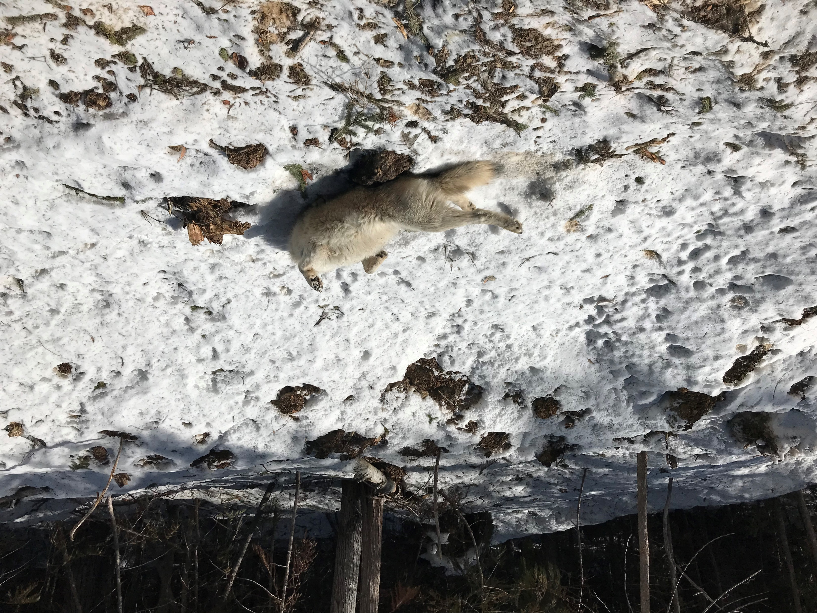
Notes:
They really like rolling around in the snow
This is NOT an invitation to pet a tummy

Slide 17
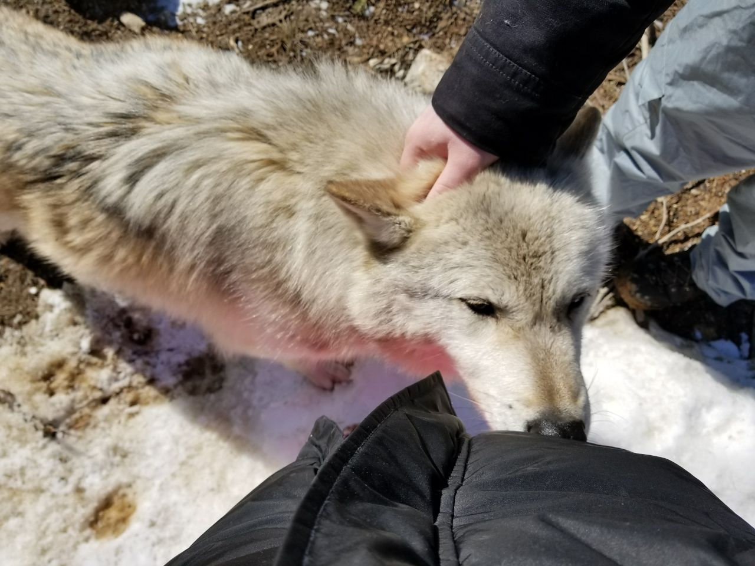
Notes:
If they like you, they’ll come up and pause near you, and you can pet them like we are here
They don’t stay long, just for a couple scritches and then they’re gone
Always moving
Fur is so coarse

Slide 18
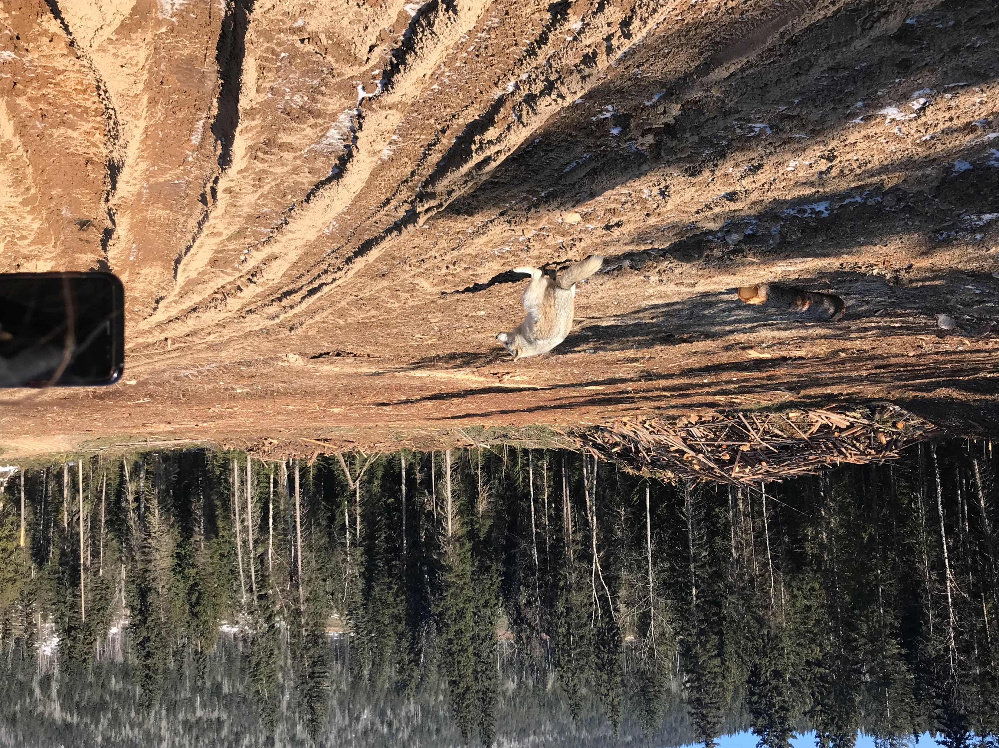
Notes:
This one doesn’t have anything to do with the story, I just thought you’d like it
Yes the wolf is pooping

Slide 19
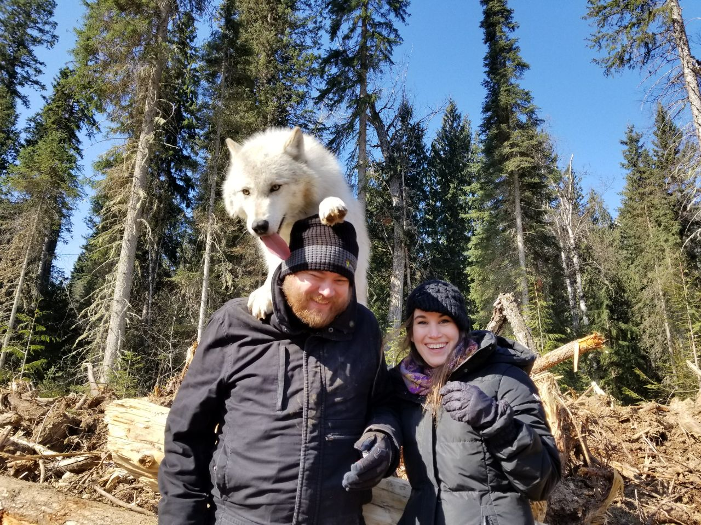
Notes:
Eventually, the guides find a spot where you can take a picture with the wolves
They toss treats, the wolves aren’t trained, but they know if they get close to the guests, they get treats
This is VERY exciting for them
They love treats
A lot
You don’t have to do it if you’re scared, but we were feeling pretty comfortable by this point
This is a photo of one of the coolest moments of my life so far
This is an amazing gift from my wife, I’ll always treasure this memory and this experience
We got a lot of cool photos here, but then something happened
Remember how wolves can be a little unpredictable?
In all the excitement, the wolf’s paw slipped off the side of my head and then her paw slipped

Slide 20
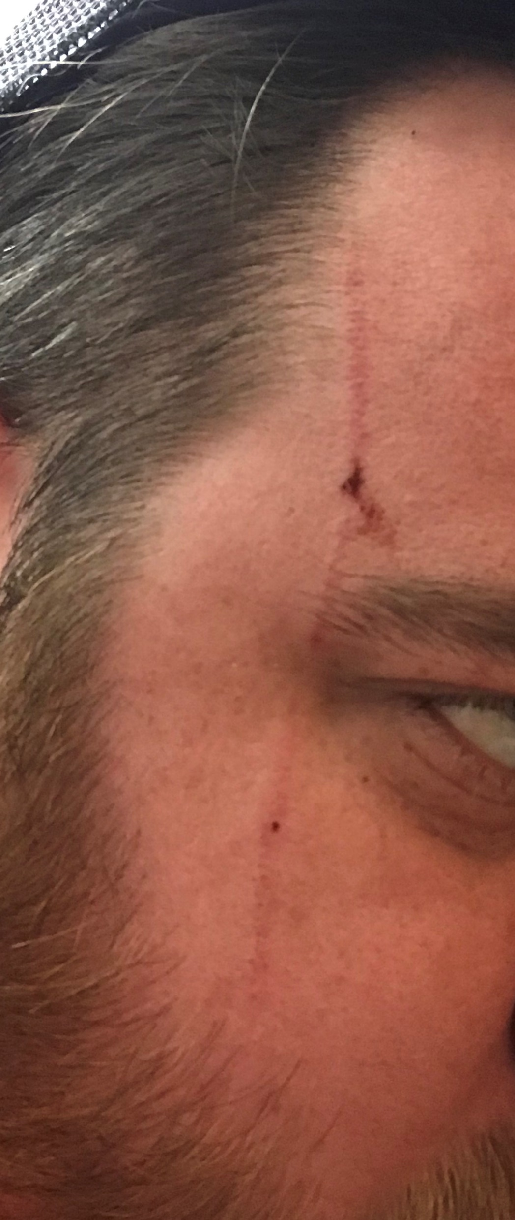
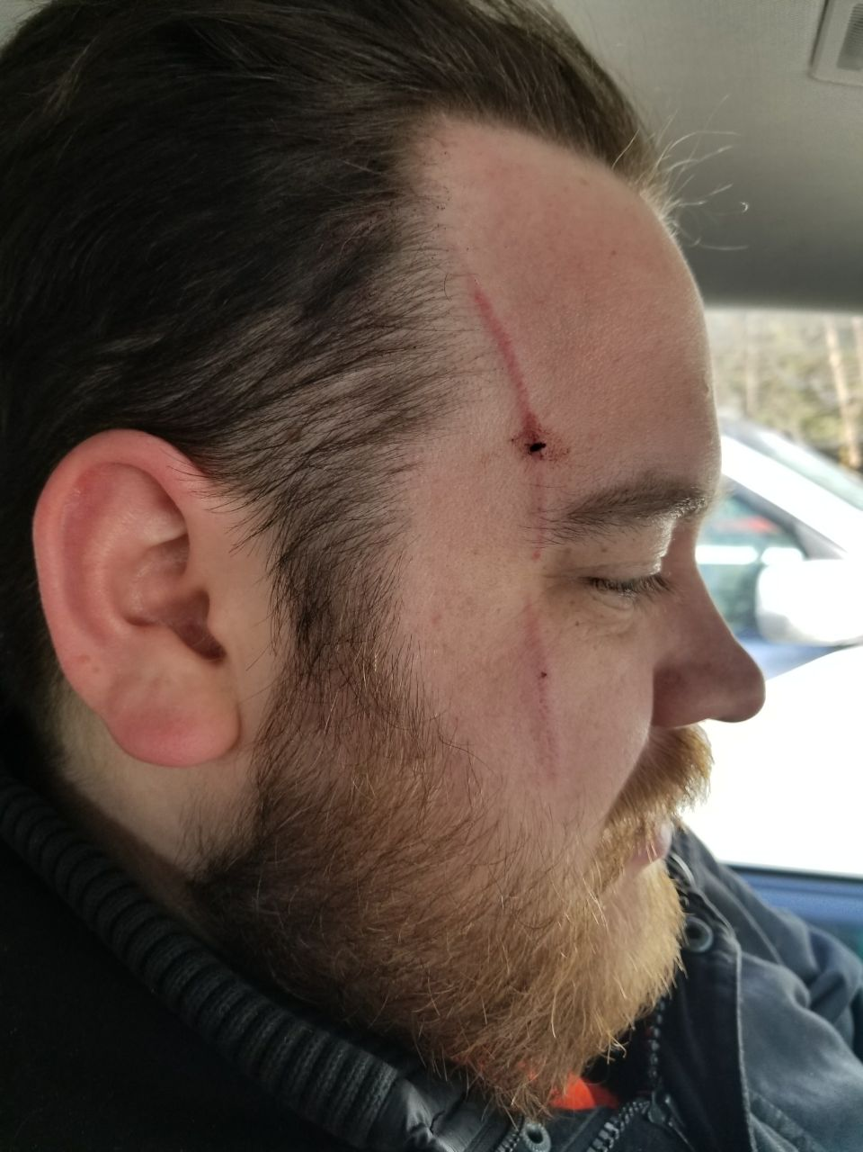
Notes:
Ouch

Slide 21
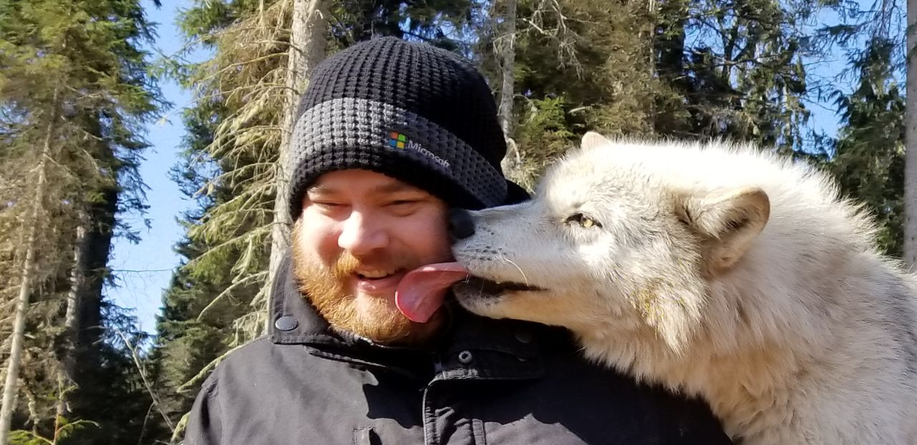

Slide 22
Questions?
@MrThomasRayner
thomasrayner.ca
github.com/thomasrayner
PowerShell Discord/Slack
Join: j.mp/psdiscord or j.mp/psslack
pluralsight.com/authors/thomas-rayner
Master PowerShell Tricks books

